Slide 1
Review Class 1
Kazi Amit Hasan

Slide 2
Upcoming schedule
March 16th >> Review class 1. I highly encourage you to attend this session, as I will highlight the most important topics and questions likely to appear on the final exam. Please use the Google Form or email me to let me know which topics you would like me to cover again. I plan to hold a couple of review classes before the final.
March 18th >> NoSQL. This class will be led by our graduate TA, Ashfi.
March 20th >> NoSQL by Ashfi
March 23 >> NoSQL by Ashfi

Slide 3
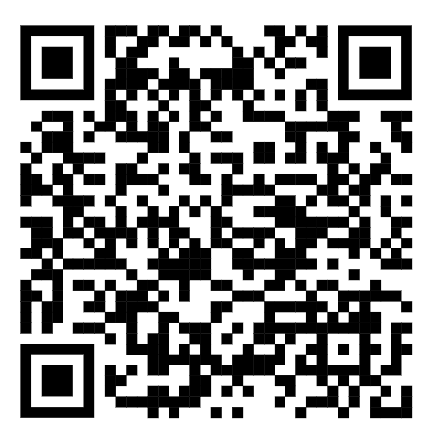
Feedback
Scan to put the feedback!

Slide 4
What we have covered so far
Introduction to Database and ER models
Relational models
Translation from ER to Relational
Relational Algebra
SQL
Application development
Storage and indexing
Security
NoSQL

Slide 5
Final Exam Format
Three sections
Multiple choice, true/false and short answers: 15 marks
ER diagrams: 10 marks
Query language: 20 marks

Slide 6
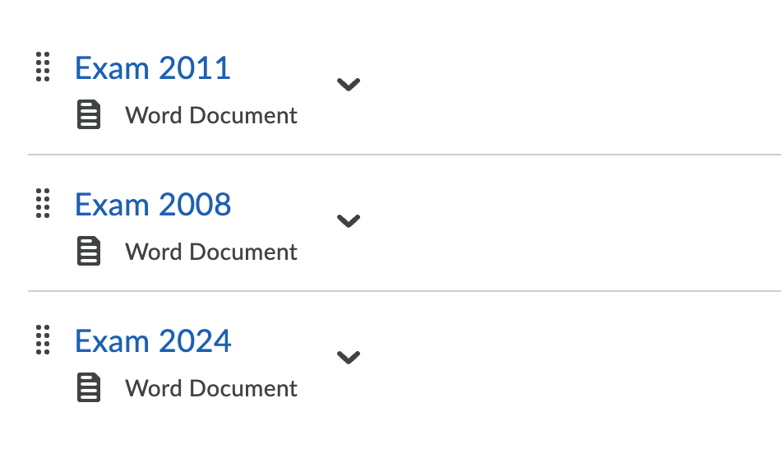
Sample Questions

Slide 7
MUST do things
ER diagrams
Careful while selecting the keys
READ question multiple times
You must denote the weak entity. If you forcefully make a weak entity to strong by assuming primary key. Marks will be deducted!
Careful with the shapes. Weak entities are different than regular entities.
Solve all solved examples in the class again

Slide 8
MUST do things
SQL queries:
Must read the questions
Must solve all solved problems in the class.
Recommended exercise:
Chapter 3, 4, 5 >> all exercise of Database system concepts 6th edition

Slide 9
MUST do things
Relational Algebra:
Must read the questions
Must solve all solved problems in the class.
Recommended exercise:
Chapter 6>> all exercise of Database system concepts 6th edition

Slide 10
Next?
Time and data of Review class 2 will be announced in OnQ
QSSET!

